Slide 1
CDM Oilfield Services Ltd.
Canadian Brake Test Guide

Slide 2
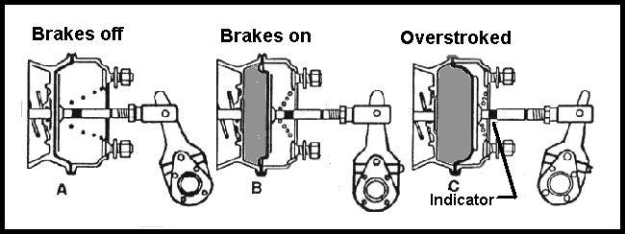
Canadian Brake Test Guide – Step 1
Step 1.Step
Engine OFF. . . Keys in pocket. Truck chocked.
All brakes released, pull on all slack adjusters, pushrod travel cannot be more then 1 inch
And during an application test no more than 2 inches.
Length of travel is determined by brake chamber diameter

Slide 3
Canadian brake test guide – Step 2, 3, & 4
Step 2.
Compressor Build Up . .. ENGINE HIGH IDLE (1250 RPM) time between 50 to 90 psi in three (3) minutes or less.
Step 3.
Air Governor cut out, cut in . . . Engine high idle cut out between 120 - 130 psi . . . Pump down air governor will cut in at 20% less than cut out.
Step 4.
Low Air Warning . . . ENGINE OFF, key in on position, pump down, alarm and low air indictor should come on at 60 psi or higher.

Slide 4
Canadian brake test guide – Step 5 & 6
Step 5
Automatic Spring Brake Set . . . ENGINE OFF, pump down, for tractor trailer both buttons should pop out (dynamite) between 30 - 45 psi. For straight truck the brake should pop prior to all air gone from the reservoirs.
Step 6
Air Leak Test . . . Build air back up, ENGINE OFF at governor cut out, brakes released (buttons in). Time and watch and listen for air leaks. Single truck, no more than 2 psi in 2 minutes. Tractor trailer, no more than 4 psi in 2 minutes.

Slide 5
Canadian brake test guide – step 7
Step 7
Air Leak Test - Foot Brake Applied ENGINE OFF (all brakes released buttons in) Full Foot Brake Application and Hold . . . Time and watch and listen for air leaks. Single truck no more than 4 psi in 2 minutes. Tractor trailer no more than 6 psi in 2 minutes.

Slide 6
Canadian brake test guide step 8
Step 8
Four Point Rolling Brake Test . . . Set brakes pickup chocks, move vehicle forward 2 - 3 meters put truck in neutral and test each brake separately. Pull red button (trailer), then do it again and pull yellow button (truck), then do hand brake and finally the foot brake.

Slide 7
END

