Slide 1
CDM Oilfield Services Ltd.
Pre-Trip Inspection

Slide 2
Why do a Pre-trip inspection
Your safety and possibly your life is at risk
Public safety
Required by law
Company policy
Peace of mind

Slide 3
Beginning a pre-trip inspection
As you approach the vehicle check the hood bumper and grill
Visually check for leaks, damage, and any obvious problems.
It is good practice to start at the front and continue around the unit. This ensures that no item is missed or overlooked.

Slide 4
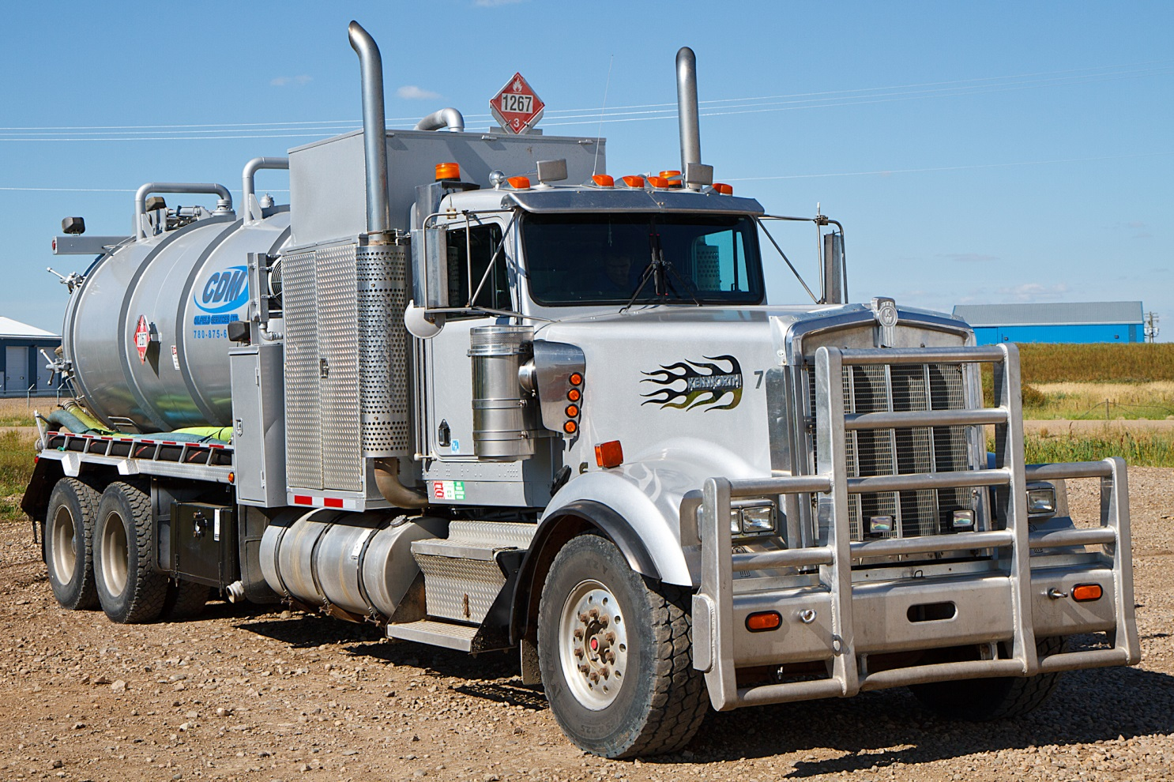
Leaks
Check for puddles under the unit
Check for drips under the engine
Leaks

Slide 5
Lift hood to engine and check the following

Slide 6
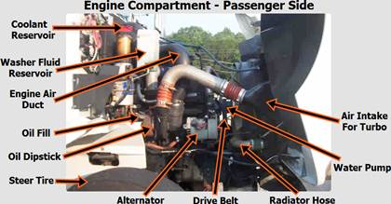
Water Pump
Mounted Securely
No missing bolts or parts
Hoses attached securely
No leaking hoses or water pump
Belts no more than 3⁄4 inch of play
Belts not cracked, frayed, or damaged
Alternator
Mounted Securely
No missing bolts or parts
Wires good connections, not frayed
Belt no more than 3⁄4 inch of play
Belts not frayed or cracked
Oil Level
Check for proper level and condition
All Hoses and Wiring
Not cracked, frayed, or broken
Belts no more than 3⁄4 inch of play
Hoses not leaking
Air Filter
Clean/Replace

Slide 7
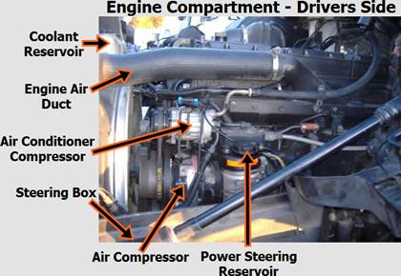
Coolant
Check for level and condition
Hoses attached and not leaking
Power Steering Reservoir
Mounted properly
Hoses attached and not leaking
Check for level and condition
Fan/Fan Belt
Ensure no cracks on blades of fan
Fan belt (No more than ½”to 1”play)
Washer Fluid
Check for proper level

Slide 8
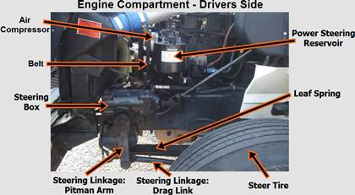
Steering Linkage
Pitman arm, Drag link, Steering knuckle, Tie rods and tie rod ends not cracked, bent or broken
Castle nuts and cotter pins not missing and in place

Slide 9
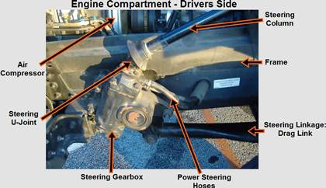
Steering Gear Box
Mounted properly
No missing parts, nuts or bolts
Lines and hoses not leaking or broken

Slide 10
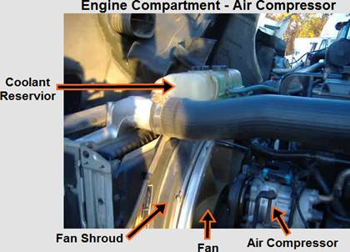
Air Compressor
Mounted Securely
No missing bolts or parts
No air leaks at lines
Check if gear or belt driven
Belt no more than 3⁄4 inch of play
Belts not cracked or frayed

Slide 11
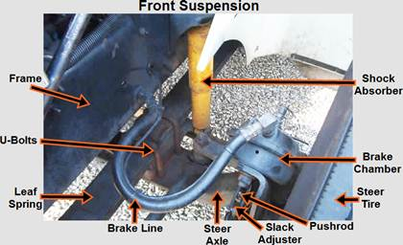
Leaf Springs
Not shifted or out of place
Not cracked, broken or missing
Spring Mounts
Mounted securely- front, back, and U-blots
Not cracked or broken
Shock Absorber
Mounted Securely
Not bent or dented
Not leaking

Slide 12
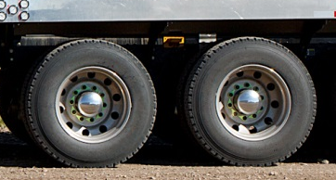
Tires
Proper inflation - company or manufacturer specification
No bulges or cuts, can have retreads
Minimum tread depth of 2/32”
Tire Spacing
Axle Seal
Rims
Not bent or cracked
No welding repairs
Log Nuts
Rim
Tire
Outer Axle Seal
Not leaking, no missing bolts
Space Or Spacer
Check for objects between wheels
Check for proper spacing
Lug Nuts
None missing
Tight – no shinny threads, or rust trails
Outer Hub Oil Seals
Not leaking, no missing bolts
Proper oil level

Slide 13
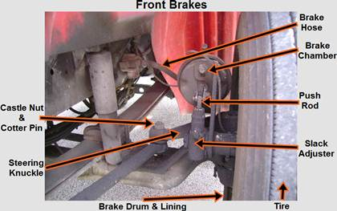
Hoses And Lines
Mounted securely
Not leaking
Not cracked or frayed
Brake Chamber
Mounted securely
Not dented or damaged
Not leaking
Brake Drums
Not cracked, broken or dented
No oil leaking from inner oil seal
Free of debris
Slack Adjuster
No more than 1 inch of free play at the push rod with the brakes released
Not bent, broken, loose, or missing parts
Brake Linings
No cracked, broken or missing parts
Not less than 1⁄4 inch in thickness

Slide 14
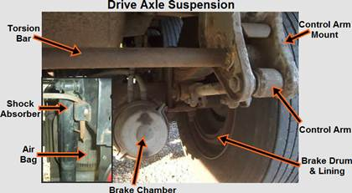
Control Arm Mount
Mounted securely
Not bent, broken or damaged
Control Arm5
Mounted securely – front, back, and U-bolts
Not cracked or broken
Torsion Bar
Mounted Securely
Not bent, broken or damaged
Shock Absorber
Mounted Securely
Not bent, dented or leaking
Air Bags
Mounted Securely
Not leaking

Slide 15

Driver and Passenger Doors
Door opens and closes properly
Seal is in good condition
Mirror
GVW––Gross Vehicle Weight The maximum loaded weight of the complete unit (trailers/attachments included).
Door
Fuel Tank
Over--weight violations are expensive and affects our Carrier Profile.
Fuel Tank
Mounted securely
Not leaking
Seal in cap OK
Driver's Mirrors
Clean and free of obstruction
Not cracked, broken, or damaged
Mounted securely
Be aware of Road Bans as they take effect

Slide 16
License Plate ––clean and readable
License Light

Slide 17
Why Keep a cab clean
Loose objects become projectiles during an accident.
Helps from getting objects lodged under the brake controls and accelerator pedal.

Slide 18
Cab Inspection
First Aid Kit ––complete
Emergency Triangles ––flares
Fire Extinguisher ––Tagged, Minimum of 10 BC, fully charged, and Securely Mounted
Spare bulb kit
Proper paperwork, as required:
  Drivers License
  Insurance/Registration
  Log Book
  Field Ticket Book
  TDG
  Permits
  Site Specific Certificates
  Policies & Procedures Binder
  Accident Kit

Slide 19
Cab inspection – continuted -
Seats
Seatbelts
Cab Cleanliness
Wipers/washer
Horn––air and electric
Free clutch movement—engages and disengages smoothly
Steering play--no more than 30 degrees
Shifter - Moves in and out of gear properly
Heater/defroster – check for air flow
Windshield – Note any cracks of chips

Slide 20
Cab inspection – gauges -
Water Temp Gauge - Gauge is working (170 – 210 degrees)
Oil Pressure Gauge - Gauge is working properly, Normal oil pressure (20 - 45 PSI), Check that the warning light goes out

Slide 21
Cab inspection – lights -
Head lamps
Running lamps
Left/Right Signal lights
Clearance marker lamps
Back-up lamps
Work lights
Hi-Low beam indicator
Dash indicators
ALL reflectors
4 Way Flashers
Violation of lamp problems
could result in an
OUT OF SERVICE
and a
Traffic Offence Ticket
being issued
It is your responsibility to insure these items are in proper working condition before you leave the shop.

Slide 22
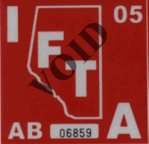
IFTA
International Fuel Tax Agreement
Ensure the IFTA sticker is on driver’s side window and of the current year
Supporting documentation must be in the unit.

Slide 23
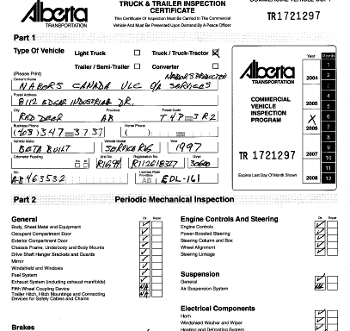
CVIP
Commercial Vehicle Inspection Program
Check for the CVIP sticker
The CVIP expires every year ––the date on the sticker indicates the expiry date.
Supporting documentation must be in the unit.

Slide 24
END

